Slide 1
Biometric Security and Privacy
Modules 1.2, 1.3(a)
By Bon Sy
Queens College/CUNY, Computer Science

Slide 2
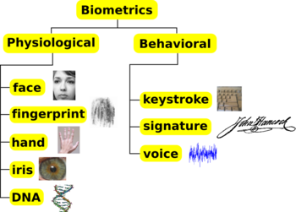
Objective of biometrics
Towards the development of automatic system for recognizing a person based on physiological or behavioral characteristics.
Generic taxonomy

Slide 3
Biometric application for security authentication
Authentication: Prove the truthfulness of what one claims through automatic recognition of:
  something one has (e.g., ID card, security token)
  something one knows (e.g., password, PIN)
  something one is or does (e.g., fingerprint, voice recognition)
A fingerprint is something one is
A fingerprint reader setup is a biometric system.

Slide 4
Recognition scenario for security purposes
Biometric verification
  Constraint conditions
  Invasive/non-invasive
  Cooperative subjects
  Controlled sensor environment
Biometric identification
  Constraint/Unconstraint conditions
  Invasive/non-invasive
  No-cooperative subjects
  Typically distant from sensors
Biometric surveillance
  Unconstraint conditions
  Non-invasive
  Non-cooperative subjects
  Distant from sensors

Slide 5
Recognition tasks of biometric authentication
Biometric verification
  Given a set of biometric templates/references {T1 T2 … Tn} corresponding to identities {Id_1 … Id_k … Id_n}, and a person claiming to assume identity Id_k presents his/her “biometric information” B_k, the process of biometric verification returns one-bit of information either accepting/rejecting the person’s claim on the identity Id_k after comparing Tk with B_k.
Biometric identification
  Given a set of biometric templates {T1 T2 … Tn} corresponding to identities {Id_1 … Id_k … Id_n}, and a person presents his/her “biometric information” B_j, the process of biometric identification returns identity information based on comparing B_k with the (sub)set of the biometric templates.
Biometric surveillance
  Similar to biometric identification but with additional annotated information such as time, location, or other specifics for information linkage purpose.

Slide 6
Non-exhaustive set of challenges related to the use of biometrics for security purposes
Choice of features for biometric pattern representation
Inter and intra variation
Effect of noise on recognition
Digital signal processing
Effect of biometric sensor
  E.g, materials for fingerprint sensors
Choice of distance and decision functions
Additional constraints such as privacy concern, inherent constraints on physical environment (e.g., lighting)

Slide 7
Biometric usability
Compare the user-friendliness across various biometric technologies
  (i.e. Face recognition, voice recognition, iris, etc…)
Factors proposed (by A. K. Jain[1]) for comparisons (H=High, M=Medium, L=Low):
  Universality: Does every user possess the biometric feature?
  Uniqueness: How unique is the biometric feature of an individual?
  Constancy: Does the biometric feature change significantly over time? How fast?
  Collectability: Is the biometric feature collectable and measurable?
    E.g., the collectability and measurability of tongue-based biometric is low in comparison to fingerprint.
  Performance: Does the biometric system allow for quantitative statements with regard to identification accuracy and speed as well as the required robustness in the face of system-related factors
  Acceptability: How likely will the potential users of the system be willing to use it?
  Circumvention: To what extent a substitute could be found? E.g., fake fingerprint.

Slide 8
Biometric technologies: a comparison
Characteristic | Finger-prints | Hand Geometry | Retina | Iris | Face | Signature | Voice
Ease of Use | High | High | Low | Medium | Medium | High | High
Error incidence | Dryness dirt, age | Hand injury, age | Glasses | Poor lighting | Lighting, age, glasses,hair | Change over time | Noise, colds, weather
Accuracy | High | High | Very high | Very high | High | High | High
Required security level | High | Medium | High | Very high | Medium | Medium | Medium
Long-term stability | High | Medium | High | High | Medium | Medium | medium
User acceptance | Medium | Medium | Medium | Medium | Medium | Medium | High

Slide 9
Example of biometrics: fingerprint system
Identification/verification through fingerprint images.
Three Basic Tasks:
  Fingerprint scanning
    (input -> processing -> extraction)
  Fingerprint classification
    (classification on the primary shapes of finger prints)
  Fingerprint comparison
    (algorithms for verification and identification)

Slide 10
Biometric sensors for fingerprint collection
On-line or off-line scanning approach
Off-line approach
  Color print of a finger rolling on a surface generating the image of the ridges.
  Images are scanned or electronically photographed.
  Slow and unpleasant for a user.
  Reliable, but infeasible for real time verification/identification purposes.
On-line approach
  Acquiring an image of a life image through sensors
    Optical sensors
    Electrical field sensors
    Polymer TFT (Thin Film Transistor)
    Thermal sensors
    Capacitive sensors
    Contactless 3D-sensors
    Ultrasound sensors

Slide 11
Biometric sensors for fingerprint collection
    Electrical field sensors
      Local variation of the electrical field generated on the finger surface.
    Polymer TFT (Thin Film Transistor)
      Light emitted upon contact when the finger is laid on the polymer substrate.
    Thermal sensors
      Registration of thermal finger image.
    Capacitive sensors
      Sensor and finger surfaces form a capacitor.
      Capacitance change due to skin relief (skin ridges and grooves)
    Contactless 3D-sensors
    Ultrasound sensors

Slide 12
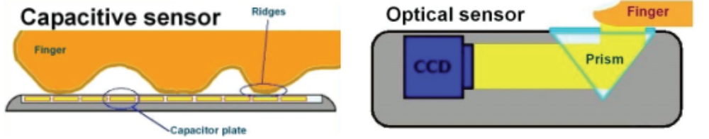
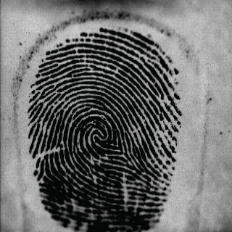
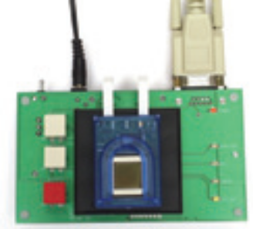
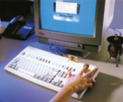
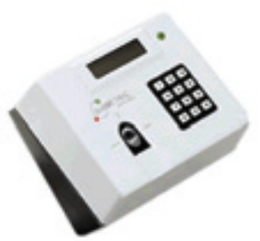
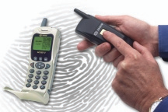
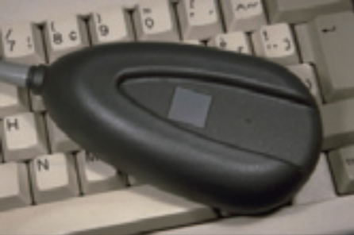
Example fingerprint sensors

Slide 13
Fingerprint image processing and enhancement
Factors affecting fingerprint image quality:
  Skin types
  Damages
  Dryness and humidity of the finger surface
Enhancement
  Optical improvement of the structures (ridges) on the scanned image.
  Image processing such as filtering and thinning in the preparation stage for feature extraction.

Slide 14
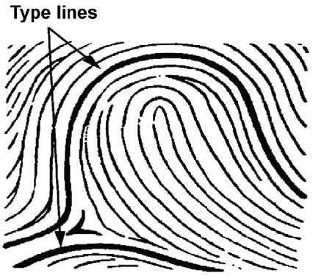
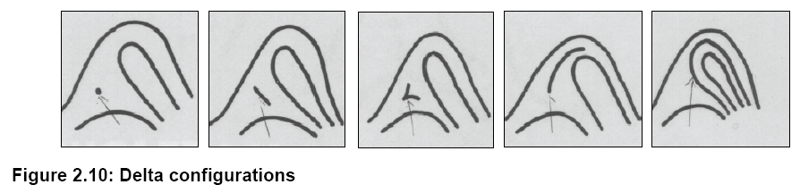
Fingerprint pattern
For classification purpose, we only concern about the pattern area.
  Pattern area is defined an inner area bounded by two type lines: delta and nucleus
    Delta is an “outer border” similar to the Greek capital letter delta formed by two parting ridges, or a ridge bifurcation and a third ridge that is convex and coming from another direction.
    Nucleus is kind of a center of the corresponding pattern.

Slide 15
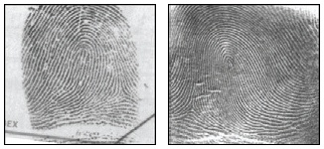
Fingerprint category: Loops
Ridges start and return from the same point in the pattern area.
They have one delta
65% of all fingerprints

Slide 16
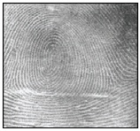
Fingerprint category: Whorls
Ridges form a twist around the nucleus.
They have at least two delta(s).
30 - 35% of all fingerprints.

Slide 17
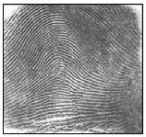
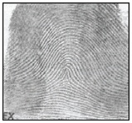
Fingerprint category: Arches
Ridges form a wave around the center, entering from one end of the finger to the other.
  Flat Arches
  High Arches
<5% of all fingerprints.

Slide 18
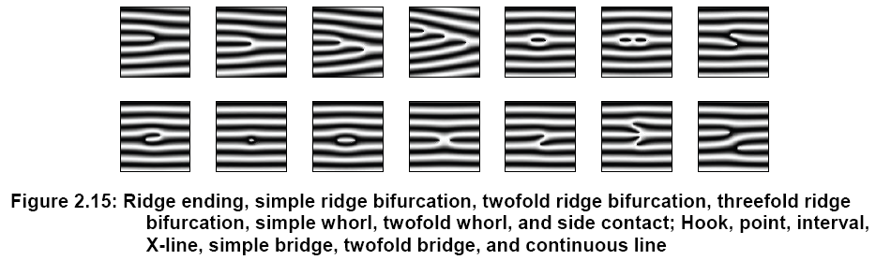
Minutiae (Anatomic characteristics of ridges
Minutiae determines the true individuality of fingerprints.
Most commonly occurred minutiae:
  Ridge ending (end of a line)
  Ridge bifurcation (a point in the ridge where the line is separated into two branches.

Slide 19
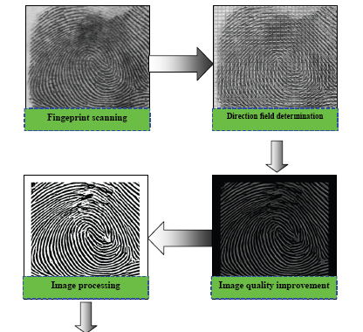
Minutiae based fingerprint identification process

Slide 20
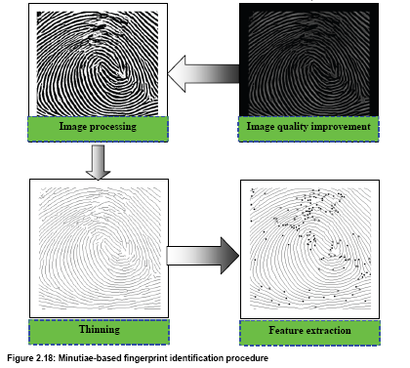
Minutiae based fingerprint identification process

Slide 21
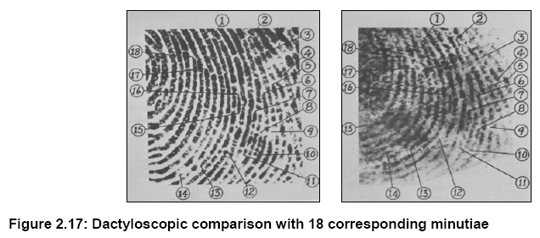
Dactyloscopic comparison based on minutiae
3 basic steps for ALL comparison procedures
  Compare major feature configurations
    Typelines, # of ridges between delta and nucleus.
  Compare the # of minutiae.
    Scanned Image >= Reference Data
  Compare the minutiae to each other.

Slide 22
Fingerprint pattern matching
Matching Score “s”– The result of a comparison of two fingerprints [0,1].
  0 – Non-Matching Pair
  1 – Matching Pair
Threshold “t” – determines the result of a comparison.
  If ( s > t ) then return true;
  Else return false;

Slide 23
Criteria for fingerprint pattern match
The general pattern configuration has to be identical.
The minutiae have to be qualitatively identical. (qualitative factor)
The quantitative factor says that a certain number of minutiae must be found. (If the minimum # of minutia is not met, fingerprint cannot be used in comparison).
There has to be a mutual minutiae relationship specifying that corresponding minutiae must have a mutual relationship. In practice, a large number of complex identification protocols for fingerprint image comparisons have been proposed. These protocols are derived from the traditional dactyloscopic methodology and prescribe an exact procedure for trained specialists.

Slide 24
Facial recognition (Bio-face)
Bio sensor and capturing device: Camera/CCTV
High quality image is hard to acquire in an unconstraint environment.
Desirable quality of image
  Taken directly from front
  Evenly and well illuminated
  No shadows or reflections
  “Lossy” formats should not distort too much the original image

Slide 25
Parameter of raw image data
Parameter of raw image data
    Pixel size in X
    Pixel size in Y
    Colors depth in bits
    Color or grey scale
    Number of colors
    File size in bytes
Image tools: IrfanView, ImageMagick
Different image formats
  Lossy JPEG, bitmap, TIFF
  Lossless JPEG

Slide 26
Noise sources and factors
Subject noise factors
  Facial expression
  Ageing
  Illness inducted changes
  Wounds
  Accessories (covering of head, spectacles, beards etc)
Photographic noise factors
  Too much or too little light
  Non-standard recording angles
  Lack of contrast
  Low resolution
  Fuzziness
  Low quality paper printing
  Transparency on image (passports)
Recording noise
  Head does not fill the image
  Images of parts other than head

Slide 27
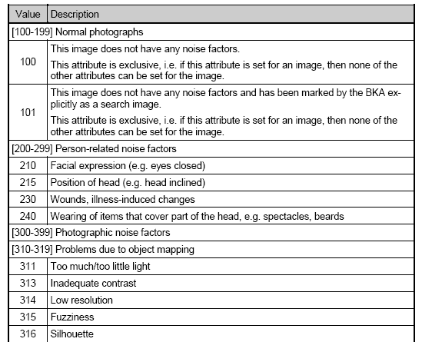
Some standardized noise categories

Slide 28
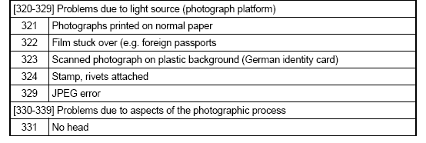

Some standardized noise categories

Slide 29
An example of facial recognition algorithm
Cognitec Systems GmbH – FaceVACS
  Face localization
  Eye localization
  Image quality check
  Normalization
  Preprocessing
  Feature extraction
  Construction of reference set
  Comparison

Slide 30
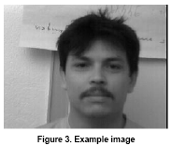
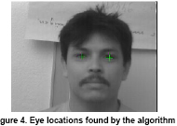
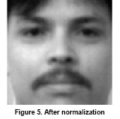
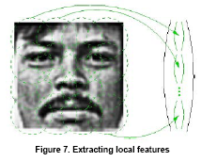
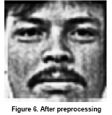
An example of facial recognition algorithm

Slide 31
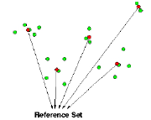
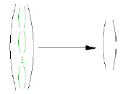
An example of facial recognition
Global transform (e.g., eigen-face … more later)
Combining cluster centers into a reference set
General form of Eigen-face detection function
Denote ||U^{T}(EB^{k}∙Y - Ḻ) - XB^{k}||₂ as 2-norm Euclidean distance
measurement, and δ^{k} as a threshold related to object class k.
||U^{T}(EB^{k}∙Y-Ḻ)-XB^{k}||₂-δ^{k} > 0 ?

Slide 32
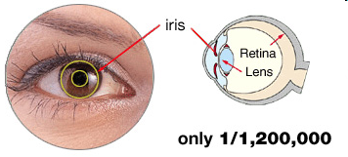
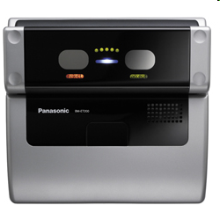
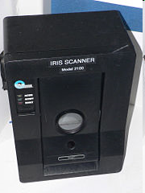
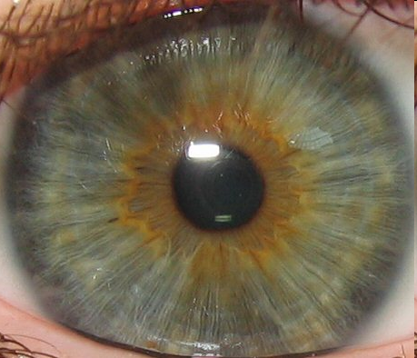
Iris biometric
http://en.wikipedia.org/wiki/Iris_recognition
IrisScan
model 2100
Panasonic
BM-ET200
Iris is the green/gray/brown area, surrounded by white sclera.
Center area is the pupil. White sclera surrounding the iris.

Slide 33
Suggested environment for Iris image capture (Daugman 94)
  Near infrared illumination is used
    Illumination can be controlled
    Un-intrusive to humans
    Easily reveals detailed structure of dark pigmented irises
  Eye position is within camera’s filed of view to capture iris image
  Eye position is located by “deformable templates”
    Set of parameters
    Expected shapes
Iris detection techniques
- Hamming distance
- Gabor wavelet transform

Slide 34
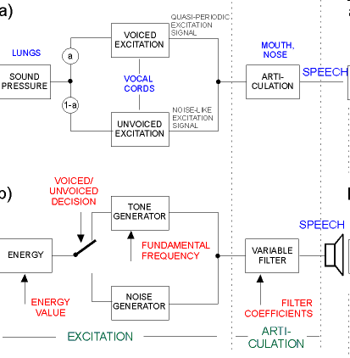

Voice biometric
Voice print relies on distinct articulation shaped by the speech production system.

Slide 35
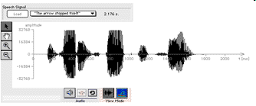
Visualizing sound as waveform

Slide 36
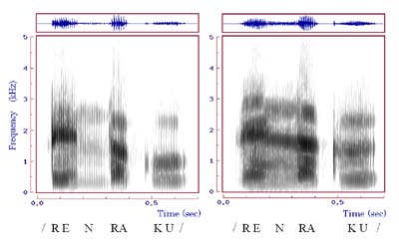
Spectrogram
2.5 Dimension display
Time
pitch (frequency)
volume (darkness indicates intensity)

Slide 37
Speech features
Two board categories: Voice and Unvoiced
More granular tuples of speech feature
  b/d: (labial stop voiced)/(alveolar stop voiced)
  d/b: (alveolar stop voiced)/(labial stop voiced)
  d/f: (alveolar stop voiced)/(labial fricative unvoiced)
  d/l: (alveolar stop voiced)/(alveolar liquid voiced)
  d/t: (alveolar stop voiced)/alveolar stop unvoiced)
  a’/o’: (front mid-to-high)/(back mid-to-high)
  a’/I’: (front mid-to-high)/(front high)
  i’/au’: (front low-to-mid)/(back low-to-mid)
  I’/e: duration

Slide 38
Speech features
More granular tuples of speech feature
  s/z: (alveolar fricative unvoiced)/(alveolar fricative voiced)
  s/sh: (alveolar fricative unvoiced)/(palatoalveolar fricative unvoiced)
  s/t: (alveolar fricative unvoiced)/(alveolar stop unvoiced)
  s/k: (alveolar fricative unvoiced)/(velar stop unvoiced)
  k/g : (velar stop unvoiced)/(velar stop voiced)
  k/t: (velar stop unvoiced)/(alveolar stop unvoiced)
  m/d: (labial nasal voiced)/(alveolar stop voiced)
  t/k: (alveolar stop unvoiced)/(velar stop unvoiced)

Slide 39
Common and different grounds between speaker verification and speech recognition
Physio-acoustic modeling based on speech feature for both speech recognition technology and speaker verification/identification technology.
Voice biometric for security application is based on speaker verification/identification, not speech recognition.
In speech recognition system, we want the system to distinguish language tokens while keeping the accuracy invariant to the speaker identity.
In speaker verification, we do not concern about whether the system recognizes the language tokens, but whether it can distinguish the speaker identity of one from another.

Slide 40
Steps towards voice biometric
Recording for voice capture
Voice pre-processing such as end-point detection
Signal processing such as signal-to-noise enhancement and noise filtering
Feature extraction based on FFT and other techniques
Biometric template model construction
Comparison based on distance function such as Kullback-Leibler distance function

Slide 41
Appealing factors for voice biometric
Low implementation cost
High user acceptance
Probably most efficient biometric modality for remote authentication
Enrollment is relatively simple
  Structured text
  Unstructured text
  Varying speech duration between 2-8 seconds
Low storage requirement

Slide 42
Cons of voice biometric
Accuracy is not the highest in comparison to, say, iris biometric
Aging and reproducibility issue of voice
Variable delay factor on voice capture; thus injecting background noise
Implementation comes from a wide variety of sensory devices for voice capture; e.g., cell phones. As a consequence, effect of noise due to the devices is less predictable.

Slide 43
Interesting developments
Current applications
  Password reset
  Probation monitoring
  Social Security Administration (employers reporting W-2 wages)
Future applications
  Standard-based voice-signed transaction
  Counter-measure for sybil attack
  Privacy preserving biometric voice application

